Slide 1
The Battle Of Neighborhoods
Capstone Project
Sheikh Jawwad Hakeem

Slide 2


Introduction
Brooklyn, New York
North York, Toronto

Slide 3

Data

Slide 4
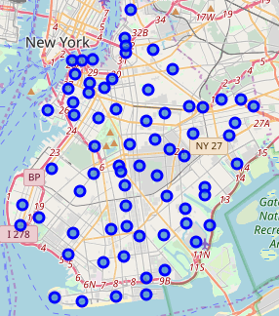
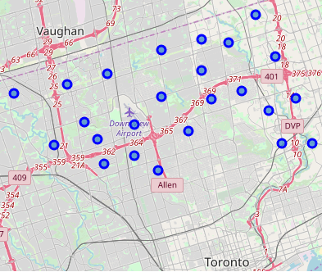
Neighborhoods
Brooklyn, New York
North York, Toronto

Slide 5
Neighborhoods
 | Neighborhood | Venue | Venue Categories
Brooklyn | 70 | 2831 | 287
North York | 24 | 251 | 111

Slide 6
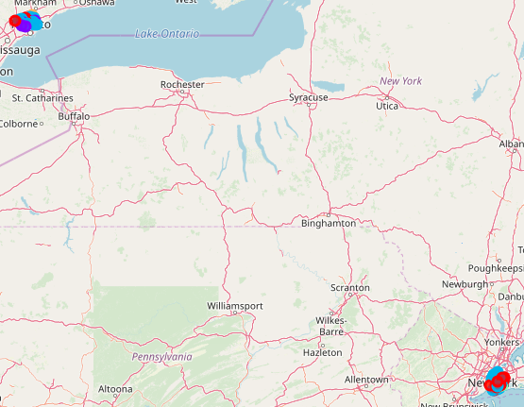
Neighborhoods – Clustered

Slide 7
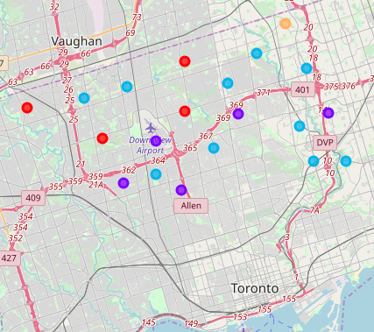
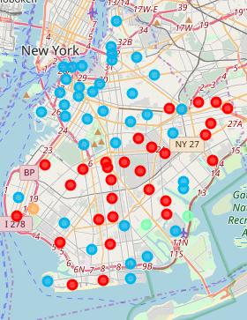
Neighborhoods – Clustered

Slide 8
Summary
Ease of decision making based on facts
Multi aspect analysis for informed decision making
Extendable to comparisons between cities, districts and countries
Useful for tourism as well

